Slide 1

Filtration & Crystallisation
7F Reactions with oxygen – What is burning?
Unit 1
Lesson 4
Yim Tin Tsai 鹽田梓

Slide 2
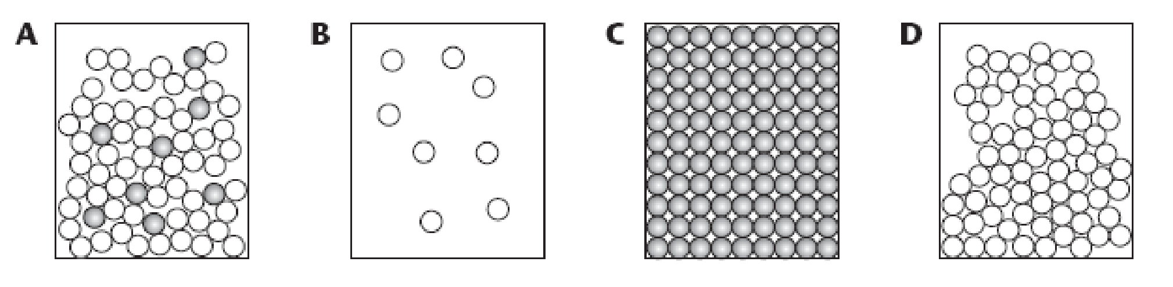
Starter: particle diagrams
Q: Which diagram shows the particles in the following?
- salt solution
- pure salt
- pure water
- steam
Notes:
A - Salt Solution B- Steam C- Pure Salt D- pure water

Slide 3
Today’s Aim
7F Reactions with oxygen – What is burning?
Unit 1
Lesson 4
By the end of this lesson I will be able to describe the techniques of filtration and crystallisation as methods for separation of mixtures

Slide 4
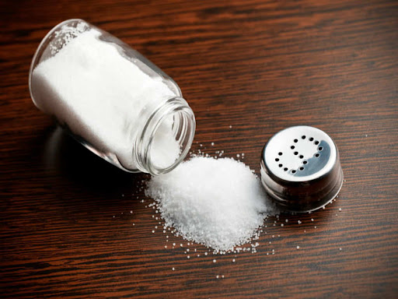
Where do we get table salt from?

Slide 5
Yim Tin Tsai 鹽田梓
Notes:
https://yimtintsai.com/en/introduction-2/
https://www.discoverhongkong.com/eng/explore/great-outdoor/hong-kong-little-salt-pan-yim-tin-tsai.html

Slide 6
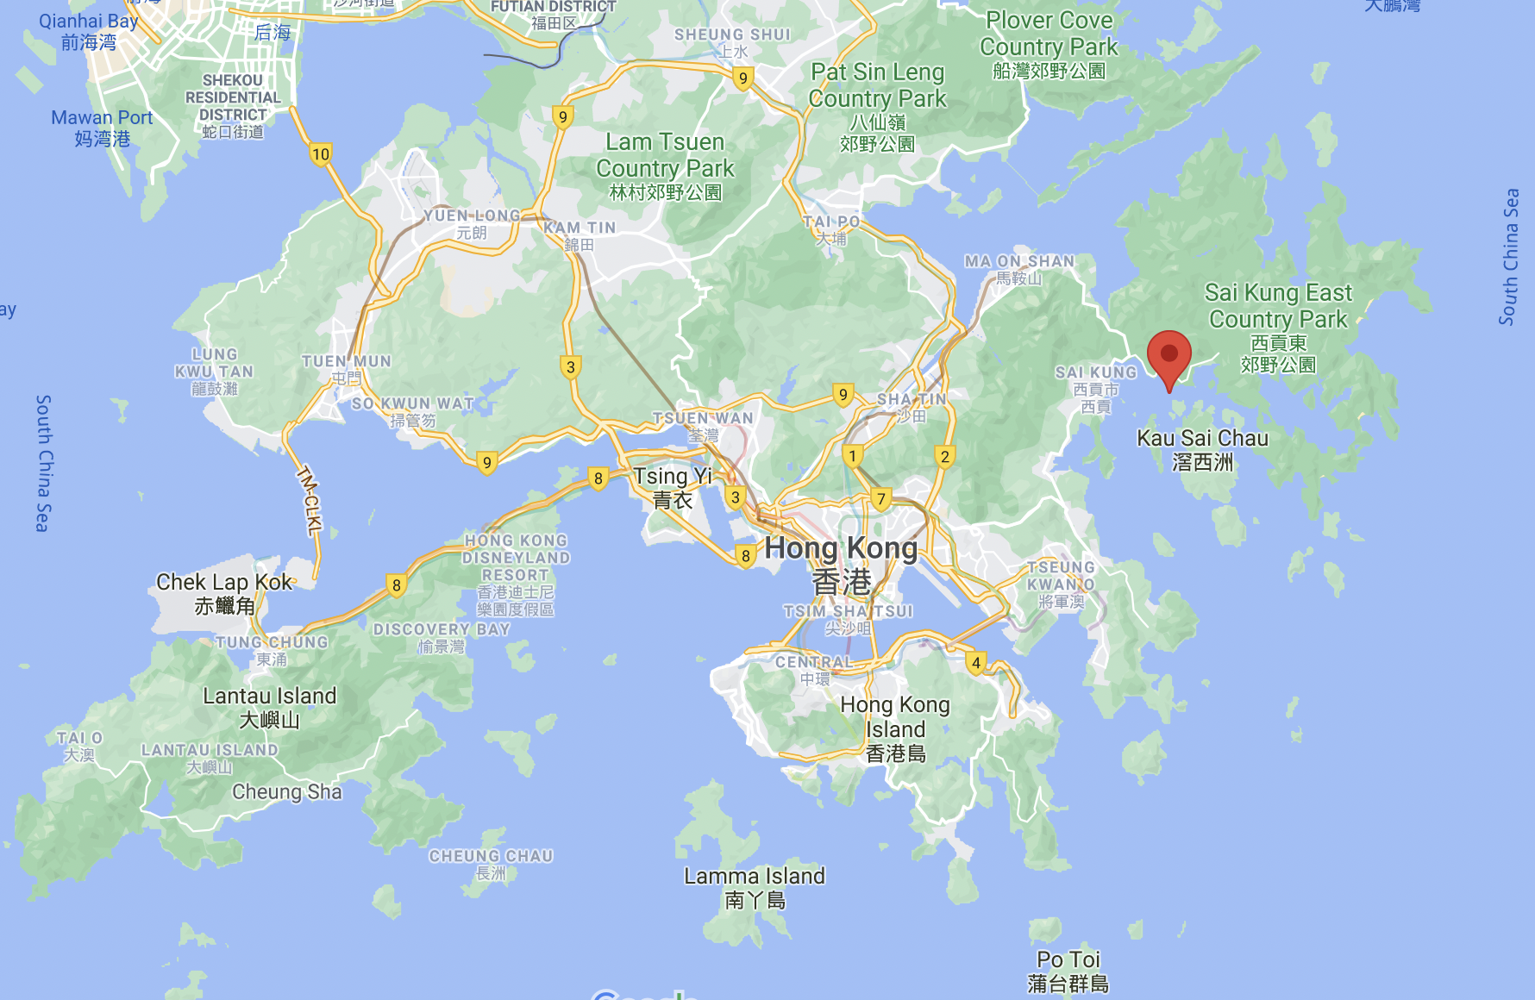
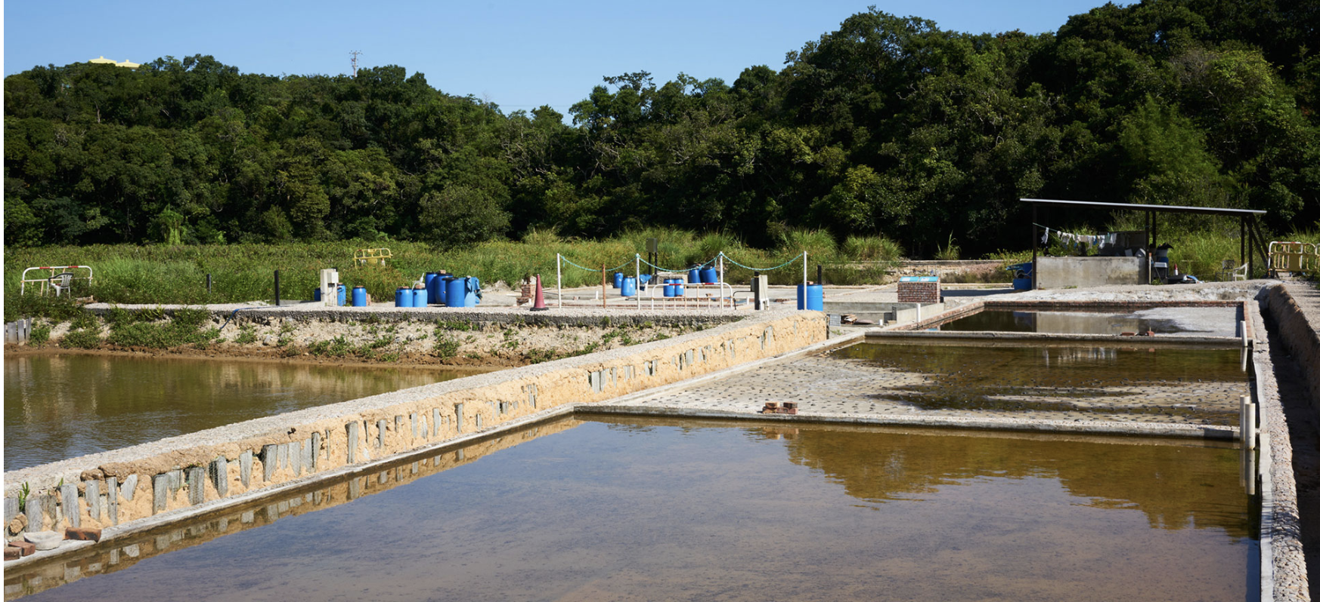
Yim Tin Tsai 鹽田梓
Salt pans, Yim Tin Tsai

Slide 7
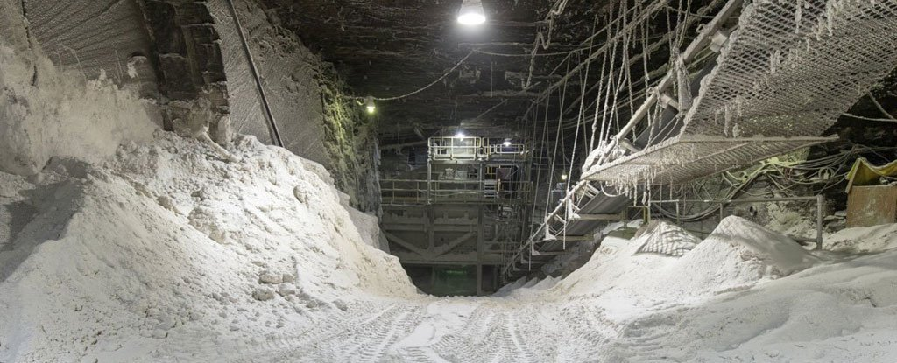
Actually most of our salt comes from mines

Slide 8
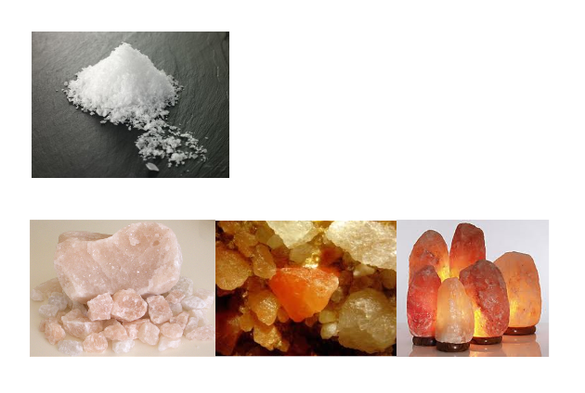
Extracting pure salt
How do we get this, pure salt
from this, rock salt?

Slide 9

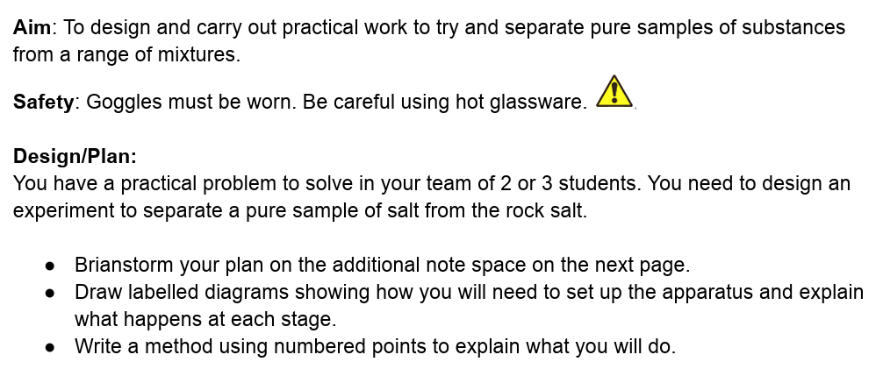

Design/plan - page 16
You could split your notes and diagrams into three steps:
mixing
filtration
crystallisation
Equipment
Safety
Scientific vocabulary
Notes:
15 minutes for planning?

Slide 10

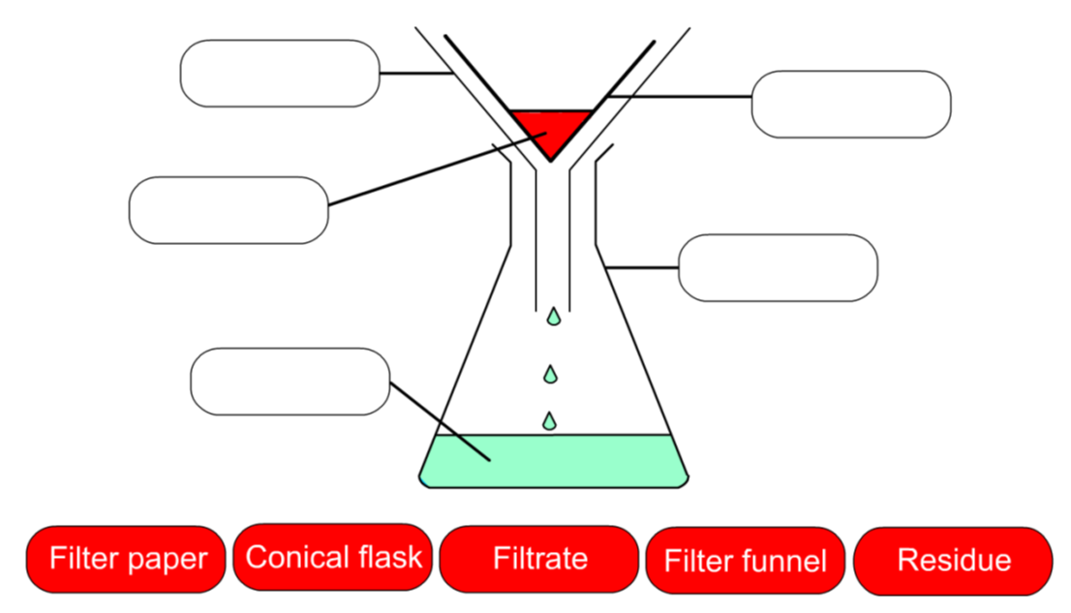
Separating Mixtures
Filtration (draw this labelled diagram on page 17)

Slide 11
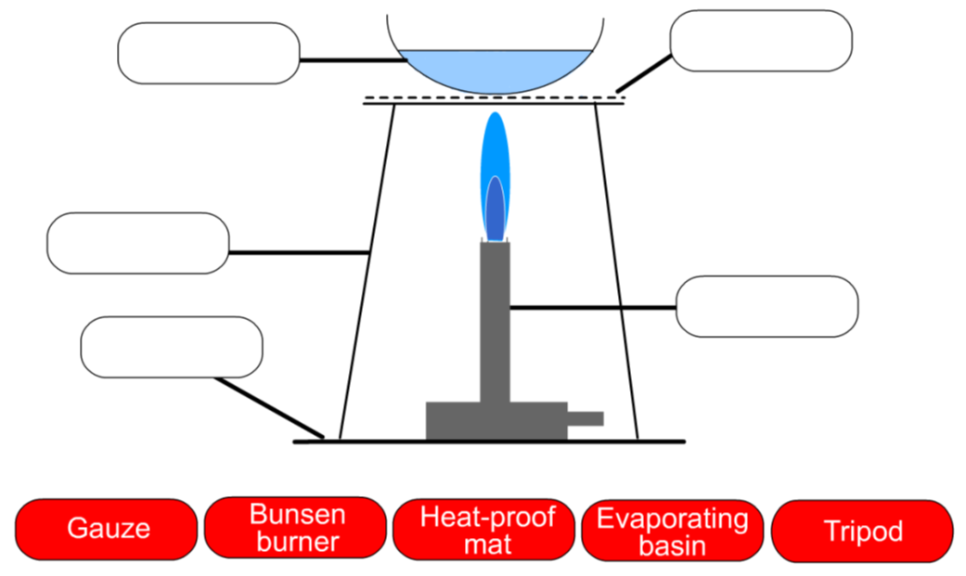
Separating Mixtures
Crystallisation (draw this labelled diagram on page 17)
heat

Slide 12
Possible method (for teacher reference):
Step 1: Measure 5g of rock salt and carefully grind up the rock salt in the pestle and mortar.
Step 2: Stir the ground rock salt into a beaker with ~20mL of water until fully dissolved.
Step 3: Carefully filter the solution through the filter paper in the funnel, into the second beaker.
Step 4: Transfer approximately 10ml of the filtered solution into the evaporating basin and set on the tripod over the Bunsen burner. Wear goggles, take care when heating Glassware.
Step 5: Heat the water until it is gently boiling and the water begins to evaporate off.
Step 6: When crystals begin to form on the sides of the basin, turn off the Bunsen burner – you now have a saturated solution.
Step 7: Leave the equipment to cool and then move the basin to a warm place to evaporate more slowly (leave at the side of classroom until next class).

Slide 13

Separation Techniques
Filtration:
to separate an insoluble substance from a solution.
Crystallisation:
to separate a soluble substance from a solution.
the longer you leave the water to evaporate, the larger the crystals.

Slide 14
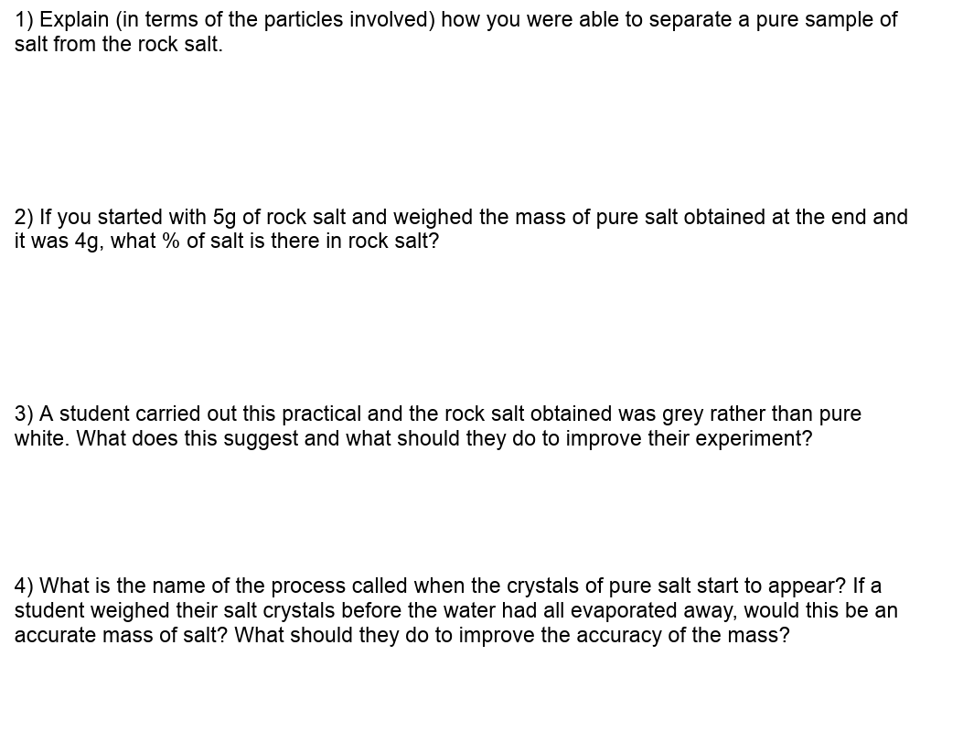
Analysis / Conclusion - page 18
Particles of salt are soluble in water. Whereas the particles of rock are insoluble. By putting the rock salt in water, the salt dissolved while the rock did not. This means the method of filtration can be used.
( 4 / 5 ) x 100 = 80% by mass.
There maybe some impurities in the salt. To test this the student could check the melting point of the solid. If it melts at an exact temperature, then it is pure. If it melts over a range of temperatures, it is impure.
Crystallisation. Weighting before all the water was removed would lead to an inaccurate result for the mass of salt. The need to leave the evaoprating basin for a longer period of time to allow all the water to evaporate.

Slide 15
Plenary: question 5
Henrique spilled some water onto a black kitchen worktop and did not wipe up the spill. The water looked clear. Eventually, the water dried but a white mark was left. What does this tell you about the water?
 | True | False | Insufficient evidence
The water was mixed with a white substance
The water was pure
The water contained a dissolved substance
The water was salty
Notes:
From: www.bestevidencescienceteaching.org

Slide 16
What you need to know
Unit 1
Lesson 4
Syllabus Content
1.10 describe these experimental techniques for the separation of mixtures:
• filtration
• crystallisation
My Learning

